Slide 1
Supported by NSF and DARPA
KnightShift: Scaling the Energy Proportionality Wall Through Server-Level Heterogeneity
Daniel Wong Murali Annavaram
University of Southern California
MICRO-2012

Slide 2
Overview
1. Measuring EP
2. EP Trends
3. KnightShift
4. Effect on EP
5. Evaluation
Overview | 2

Slide 3
Measuring Energy Proportionality
Energy Proportionality Curve
Actual – empirically measured power usage
Linear – extrapolated from peak to idle power usage
Ideal – utilization and power are perfectly proportional
Server A
Server B
Measuring EP | 3

Slide 4
Dynamic Range (DR)
DR=60%
DR=50%
DR is a course first-order approximation of EP
…but it is not accurate – only measures two extremes
Ignores power consumption at intermediate utilizations
Assuming 100W peak and Google datacenter utilization^{[1]}
Server A = 68.6W , Server B = 64.6W
How can we accurately quantify EP?
[1] L. Barroso and U. Holzle,“The Case For Energy-proportional Computing,” Computer, Dec 2007.
Measuring EP | 4

Slide 5
Energy Proportionality (EP)^{[2]}
EP=53%
EP=57%
EP is a better indicator of energy usage than DR
Why is DR not enough?
EP = DR + how linear the energy proportionality curve
???
[2] F. Ryckbosch, S. Polfliet, and L. Eeckhout, “Trends in Server Energy Proportionality,” Computer,2011.
Measuring EP | 5

Slide 6
Linear Deviation (LD)
Superlinear
Sublinear
Linearly Energy Proportional (LD=0) EP=DR
Superlinearly Energy Proportional (+LD) EP<DR
Sublinearly Energy Proportional (-LD) EP>DR
LD shows how far off the actual EP curve is from the linear EP curve
Measuring EP | 6

Slide 7
Proportionality Gap (PG)
Proportionality Gap (PG) @ utilization x%
Measuring EP | 7

Slide 8
Energy Proportionality Trends
SPECpower_ssj2008
Measures performance and power at 10% utilization intervals
291 servers
November 2007 – December 2011
Trends | 8

Slide 9
Dynamic Range Trends
2007-2009
DR improves from 50% to 80%
Since 2009
DR stalled at 80%
100% DR very difficult
Power supplies, voltage converters, fans, chipsets, network, etc.
Trends | 9

Slide 10
Energy Proportionality Trends
EP also stalled around 80%
Caused by DR
High EP servers are -LD
Since DR growth stalled, the only way to improve EP is through lowering LD
Trends | 10

Slide 11
Proportionality Gap Trends
Large PG at low utilization regardless of EP
As EP improves, PG at high utilization near 0
Energy disproportionality at low utilization will be the main obstacle to achieving perfectly ideal EP
Trends | 11

Slide 12
Energy Efficiency Trends
Energy efficiency is defined as ssj_ops/watt
Energy efficiency at high load has grown dramatically
Energy efficiency at low load has grown slowly
Most datacenter workloads spent majority of time at low load
Low utilization energy efficiency growth must be addressed to improve overall server energy efficiency
Trends | 12

Slide 13
Overcoming the EP Wall
EP stall primarily caused by stall in DR
Main focus has been improving peak and idle power consumption
To improve EP in the future:
Improve LD
Target large proportionality gap at low utilizations
Previous server-level low power modes are inactive
Exploits idle periods → DR improvements
There is now a need for server-level active low power modes
Exploits low utilization periods → LD/PG improvements
Trends | 13

Slide 14
KnightShift Server Architecture
Server-level active low power mode solution to exploit low utilization periods
Basic Idea -- fronts a high-power primary server with a low-power compute node, called the Knight
Knight capability = fraction of throughput compared to primary server
KnightShift consists of 3 components:
KnightShift hardware
System software
Supports certain functionality (data sharing, networking, etc)
KnightShift runtime
Supports KnightShift functionality
KnightShift | 14

Slide 15
Ensemble-level KnightShift
Primary Server and Knight contains independent CPU/Memory/Chipset
Independent power domains
Remote wakeup through wake-on-lan
Shared Disk (NFS)
Networking through simple router
Communicate b/t both nodes
Expose only Knight’s IP
Requires Knight to stay on
Implementation Options:
Ensemble-level (Commodity parts)
Board-level (Motherboard Intg.)
Server-level (Add-on board)
KnightShift | 15

Slide 16
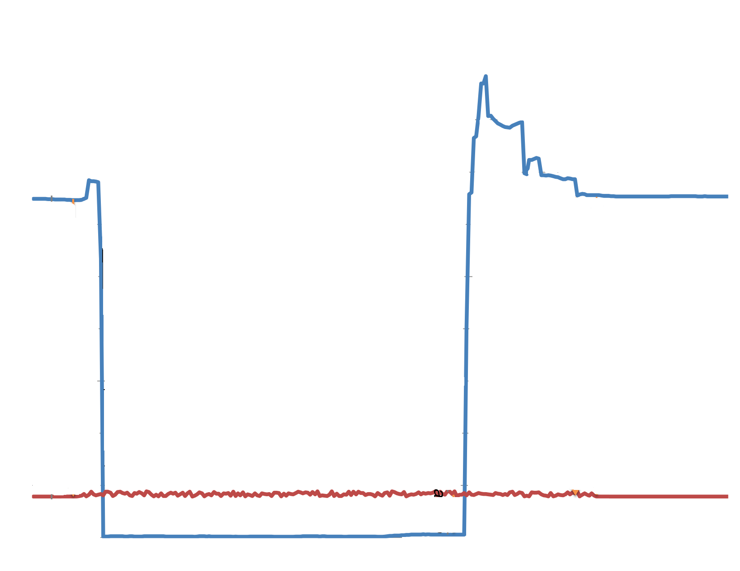
KnightShift Runtime
Example KnightShift operation
Low
High
Primary: Flush
memory state
Primary Server
Primary: Wakes up and sends awake message
Primary: Send sleep message and enter low power state
← Power Consumption →
Sleep
awake
sync
Knight: Flush memory state. Sends sync message.
Primary: Begin processing requests
Knight: Begin processing request
Knight
Knight: Sends wakeup message
Wakeup
KnightShift | 16

Slide 17
KnightShift Runtime
Monitors server utilization
Mode switching policy
Aggressively switch into the Knight
Conservatively switch out off the Knight
More optimized policy will improve response time at cost of energy
Redirect requests (Using scheduler/web balancer)
Forward incoming requests to active node
Coordinating mode switching
Ensure data consistency
KnightShift | 17

Slide 18
Effect of KnightShift on EP
KnightShift-enhanced 291 SPECpower servers
Theoretically scale power of Knight
Power_{Knight} = C^{1.7} × Power_{Primary,} with Knight capability C
KnightShift EP | 18

Slide 19
Effect of KnightShift on PG
20% Knight 50% Knight
KnightShift effectively close the proportionality gap
at low utilization
KnightShift EP | 19

Slide 20
Effect of KnightShift on EP and LD
KnightShift essentially shifted all servers to –LD
All servers now have EP>60% (from 20%)
Some servers with EP=1
KnightShift can achieve ideal EP!
KnightShift EP | 20

Slide 21
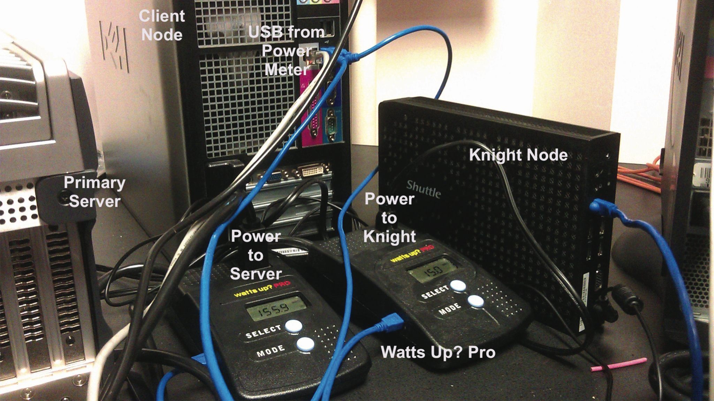
Prototype Evaluation
Primary Server
Dual 4-core Intel Xeon L5630
500GB HD, 36GB DRAM
156W-205W
Sleep/Wakeup time 5/20s
Knight
Intel Atom D525 (15% capable)
500GB HD, 1GB DRAM
15W-16.7W
EP improved from 24% to 48%
Evaluation | 21

Slide 22
Prototype Evaluation
Wikipedia-based benchmark (WikiBench)^{[3]}
Cloned Wikipedia database dump
Request trace from actual Wikipedia traffic
[3]Wikibench – http://www.wikibench.eu
Evaluation | 22

Slide 23
Prototype Results
High power usage during high utilization
Knight saves significant power during low utilization
Queuing model simulation
Sensitivity Analysis
Utilization patterns
Knight capability
Transition time
Evaluation | 23

Slide 24
Conclusion
EP growth stalled by DR
Large disproportionality at low utilization
Key to improving EP
Improve LD
Target low utilization proportionality gap
Need for server-level active low power mode
KnightShift exploits low utilization periods using a Knight
Enables high efficiency at low utilization
Effectively improves DR, LD and closes PG gap at low util.
In some cases, achieves ideal EP
Conclusion | 24

Slide 25
Thank you!
Questions?
Conclusion | 25

